Slide 1
Social Care and Inclusion Managers Forum 25th February, 2015 Better outcomes at lower cost Warm Welcome

Slide 2
Energiser

Slide 3
Setting the Scene – Keith Skerman

Slide 4
Adult Social Care & Inclusion Operating Model Translated into Delivery – Terry Hawkins

Slide 5
Vision and Ambition
Making a positive difference to the lives of
Walsall People
Paradigm shift from professional dependency; deficits; gate keeping and resource rationalisation
to
Delivering Efficiency through Excellence
Prioritising attachment - localised ethos of capability and capacity
Partnership co-production; integrated modes of delivery , intrinsically involving users and carers
Evidenced based total outcome focused delivery
Promote self care; self fund; self purchase
Notes:
Taken from ED presentation

Slide 6
Operating Model Principles
Single point access – Maximising Resolution:
information and self help; self manage
24/7 contact; signposting; referral; MDT – initial assess / screening
24/7 response; reablement and short term provision
Consolidated front facing equipment access point
Consolidated Assessment, Support and Case Management Service
All Commissioned Services Brokerage function
Provider Services - targeted provision

Slide 7
Operating Model Principles
Effective Deprivation of Liberty interventions
Integration defined by access and pathways across:
Acute and community clinical localities;
Transitions;
Safeguarding
Attachment - Asset Based and Outcomes Focused across:
Safeguarding;
Assessment, Support & Case Management;
Commissioning;
Provision

Slide 8
Operating Model Predicated On
Well defined leadership
Embedded management standards
Aligned skills mix and role harmonisation
Empowered staff base with accountability
Culture of performance management
Quality Assurance Framework
Targeted Collaboration - Public Health Prevention
Defined criteria; process and pathways
Full involvement of user and carers

Slide 9
Change Projects
Contact Centre Review
Assessment, Support and Case Management Service (including community)
Brokerage and Business Support
Reablement Review
Provider Review
Joint Commissioning Unit Review
Making Safeguarding Personal
Underpinning Electronic Systems
End to End carers pathway planning

Slide 10
Operationalisation
Asset Based
Community
Development
Prevention
Public Health
Resolution
Focused
Single
Point of
Contact
Attachment
Strengths Based
Case
Management
Reassess
Assertive
Review
MDT
Initial Assess
Refer
Strategically
Commission
For
Outcomes
Operationally Commission
Equipment
Provision
Response
Reable
Transitions
COP
Appointees
Community Based
Risk
Stratification
Robust Market Shaping
Transparent
and
systematic
brokerage
Making Safeguarding Personal

Slide 11
Data Flows As At December 2014
Initial Referral Team
3435 calls
687 signposted
1776 calls transfer
602 referrals
Initial Assessment
219 Referrals
10 Redirected
81 Outer borough
96 Assessments (re)
616 Allocated
45 Unallocated
CIC
207 referrals (157 people) Dec
36 redirected (OT; NCO)
232 Allocated (82 Dec)
Community Alarms
18821 calls
23% outgoing
838 Response call outs
3075 equipment issues
Bed Based IC
47 Admissions
Complex
33 Referrals
22 allocated/awaiting
106 unallocated cases
I D T
188 referrals Dec
67 redirected to CIC
1 redirected to Review
NCO
261 referrals (50%completed)
5 redirected (CIC; IAT)
333 allocated waiting
Dec 141 allocated/awaiting
Dec 115 completed
Review
97 Referrals Dec
75 assessments (re) Dec
49 unallocated
Planned reviews complete 638
Planned reviews outstanding 658
45% reviews completed out of time
Emergency Duty Team
23 referrals Dec
22 redirected - NCO; IAT
1 signposted
Sensory Support
55 Referrals Dec
14 completed Dec
193 allocated
42 awaiting
ILC
51 referrals Dec
5 redirected OT
89 allocated/awaiting
Dec 32 allocated/awaiting
OT
193 Referrals (10 redirected) ILC) Dec
850 Allocated (Dec 36)
Dec 132 unallocated
RAP
115 Funding Panel (community)
29 Long term placements
3 short term

Slide 12
Charging Policy for Community Based Social Services update – Lisa Koc

Slide 13
Drivers for refreshing the Policy
Findings of the Local Government Ombudsman in March, 2014 – recommendation that the council completed a review of the charging model it uses for Housing 21 Extra Care
Further recommendations in July, 2014 suggests consideration of how the Benefits Based policy was applied, in particular eligibility for a particular Welfare Benefit
Preference –aligning all existing policies into one
Care Act 2014 – single legal framework for charging for care
and support

Slide 14
Care Act - requirements
“All councils should have transparent charging policies .....service users, carers and the public should understand the purpose of local charging policies and the criteria used to determine levels of charging for particular services”
The new framework is intended to make charging fairer and more easily understood by everyone
The framework is therefore based on the following principles:

Slide 15
Care Act 2014 - requirements
People are not charged more than is reasonably practicable for them to pay
The policy is comprehensive to reduce variation in the way people are assessed and charged
The policy is clear, transparent , applied equally
The policy promotes wellbeing, social inclusion and supports the vision of personalisation, independence, choice and control
The policy supports carers to look after their own health and wellbeing and to care effectively and safely
Is person focused, reflecting the variety of care and caring journeys and the variety of options available to meet their needs
Enables and encourages those who wish to stay in/take up employment, education or training
Is sustainable for local authorities in the long term

Slide 16
Consultation 8 December – 13 February
Cabinet approved a period of consultation in September
2014, this included:
An initial letter explaining that a period of consultation would be undertaken
A series of pre-consultation/engagement activities during November 2014 to find out what people thought about the current policy/ideas for how things could be different – included focus groups, 1-2-1s, group discussions, workshops, telephone/written feedback
Formal consultation period began on 8th December and ceased on 13th February (8 public meetings, 14 drop in sessions) - further letter/questionnaire sent to 7,542 with over 900 responses received

Slide 17
Consultation
Response was positive – more than a 1000 people engaged
Overall reach of the consultation exercise in terms of percentages was broadly representative of the population who use our services
Detailed EQIA produced
Variety of different formats used to engage people in the process, Easy read, Audio, Braille, BSL, supported completion, support from Walsall Deaf People’s Centre
Full consultation results and EQIA available upon request from the Programme Office

Slide 18
Cabinet Report recommendations
Contributions will be calculated using individual costs through a financial assessment
Walsall people contribute what they can reasonably afford, retaining their basic Income Support or pension credit guarantee level and a protection of 25% before they are asked to make a contribution
Contribution will not exceed either the actual cost or a person’s personal budget for all council funded social care
Benefits advice / maximisation will be available throughout the process
Contributions will not be required for the cost of the assessment
Services to meet assessed need won’t be refused /withdrawn if an individual does not pay their assessed contributions or lodges an appeal, however debt recovery including Court Action may be pursued
Disability related expenditure – options currently being looked at

Slide 19
Cabinet Report recommendations
A flat rate charge be applied to simple preventative services when people are ineligible for funding for a social care service eg., a suggested charge for emergency response would be £3.92 per week for people in receipt of a community alarm
Maintenance of existing income levels – 100% of disposable income is the preferred option
Deduction of social care costs from DPs prior to payment (net payments)
No charge for carers services
Charges for equipment over £1000 which does not meet the criteria for DFGs

Slide 20
Timeline
Running alongside this are the preparations for implementation
Activity | Date
Draft report for decision finalised | 9th March, 2015
Report to Scrutiny | 12th March, 2015
Cabinet Meeting | 18th March, 2015
Policy becomes effective | 6th April 2015

Slide 21
Next Steps - Implementation
Advocating a strong project management approach with clear roles, responsibilities and a TOR – this is a cross directorate project
Implementation Plan – includes any phasing, key activities and interdependencies
Key deliverables, policy document to come from existing core group plus
Data gathering (income and savings data)
Public information
Financial assessment process and documentation
Financial contribution calculator tool/model
System for storage, Mosaic – long term solution
System for billing (oracle) and corporate debt management
Staff and resources - staff procedures and training - agreement across directorates

Slide 22
Comfort Break

Slide 23
Adult Social Care & Inclusion Savings and Efficiency Delivery – Terry Hawkins

Slide 24
Vision and Ambition
Making a positive difference to the lives of
Walsall People
Better outcomes at lower cost
Through
Utilising all resources targeted on efficient delivery of a better customer experience and improved outcomes
Focus on productivity, more for less/same
Efficiency, effectiveness and Economic
Form and Function
Notes:
Taken from ED presentation

Slide 25
Savings – 2016/17
Care and Support – Reduced packages of support
Learning Disabilities – re-provision
Housing 21 Contract - Efficiencies
Service Level Agreements – review third party funding
Section 75 Agreement – Reduce costs
Day Opportunities – New model

Slide 26
Savings – 2015/16
Care and Support – Reduced packages of support
Learning Disabilities – re-provision
Apprenticeships – withdrawal
Recruitability Payments – withdrawal
Fallings Health – Delivery of efficiencies
Strategic Support – Programme Office/Paris and Performance Team
Total savings target £3.3m

Slide 27
Savings – 2016/17
Links to Work – Redesign
Community Alarm/Charging Savings
Business Support – Efficiencies/Mosaic
Strategic Support – Programme Office/Paris and Performance Team
Total savings target £5.9m

Slide 28
Better outcomes at lower cost
Improved Performance
Flexibility, creativity, new ways of working
Problem solving focus
One service, one vision
Challenging!

Slide 29
Better outcomes at lower cost – Rick O’Brien

Slide 30
Achieving efficiencies through support planning

Slide 31
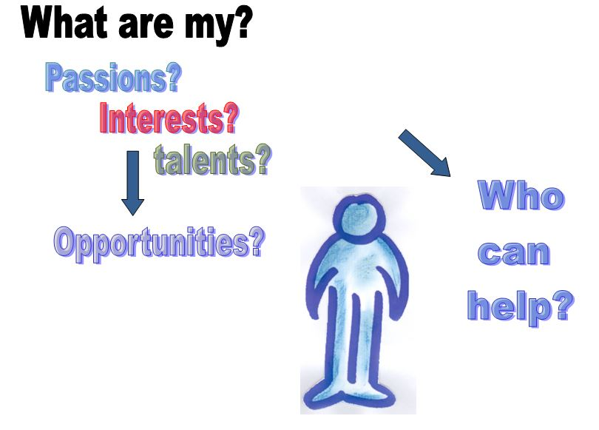
Maximising assets (My gifts and skills)
What do I bring in terms of personal qualities, talents, skills and material resources, that
can help make the changes that I want.
How is my individuality is expressed in the way I want to live my life
How can I develop my support plan to build
on and use my talents and how to express
my lifestyle?
How my interests create the possibility of a connection with other people, opportunities
for work or interests to explore

Slide 32
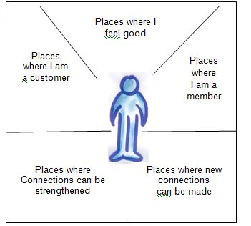
Maximising Assets (Community Connections)
Be clear about what places and connections work
for you now, what you want to change, or keep
The same in your life; possible opportunities
you take and include in your support plan.
Looks at the balance in your life between paid support, other types of support, and how to use
the financial resources effectively.
You may find support that is already available,
rather than introducing paid support
Think whether you wish your support plan, and
the resulting funding to support you to
strengthen your community participation.

Slide 33
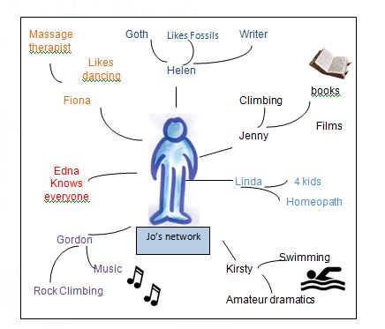
Maximising assets ( My relationships)
Who you know, how you know them,
who knows who and how their networks
can help find opportunities and support
with how you want to live your life.
Find opportunities and resources in your
Web of social networks. Shows if there
are other people you could share
resources with.
There may be other people you think of
as you map out your networks.

Slide 34
Quiz Andie Oliver

Slide 35
Managing the Money – Tracey Evans

Slide 36
Finance & ASC – partnership working
From the list of issues from finance – which relate to:
training?
access to the right information?
finding the time to do it?
other?
please record on the sheet Tng, Info, Time, Other (state)
Table Top & feedback
“Do not complete monthly forecasts”
– so if not, why not?!

Slide 37
Intelligence Driven Organisation - Anne Doyle

Slide 38
Underpinning the Operating Model
Organisational Development
Transformational Skills
Transactional Skills
Strategic Intent
Evidence Based Decisions
Demonstrating Success
Driving Change
Culture
Proactive Predictive Analysis
Notes:
Successful organisations exploit information
Qualitative and Quantitative
Exploit management and intelligence systems
Operate in a framework of governance
Statutorily we can access a wealth of intelligence - yet how often do we utilise our intelligence to inform our thinking
Alignment of PH, NHS and Social Care Outcomes Frameworks
Refresh of JSNA and local area profiling
Consider intelligence as underpinning bedrock to the change projects underway
Have the opportunity to develop an client information system, which underpins our operating mode, where change control is well managed
Risk Stratification modelling supported by implementation of a unique identifier approach
Localised reporting to support case management, real time reporting

Slide 39
Q and A Keith, Terry & Andy

Slide 40
Closing Remarks Keith Skerman

